Slide 1
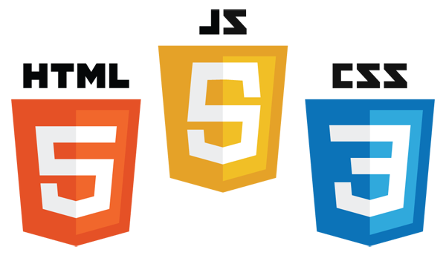

CEP Web Dev 2
Introduction to CSS
tinkercademy.com

Slide 2

Schedule
About you, about us, and what is the Internet?
Inspecting the Web
Making our own webpages with CodePen
HTML
CSS & Animations
Javascript
jQuery
Never Gonna Give You Up Generator

Slide 3
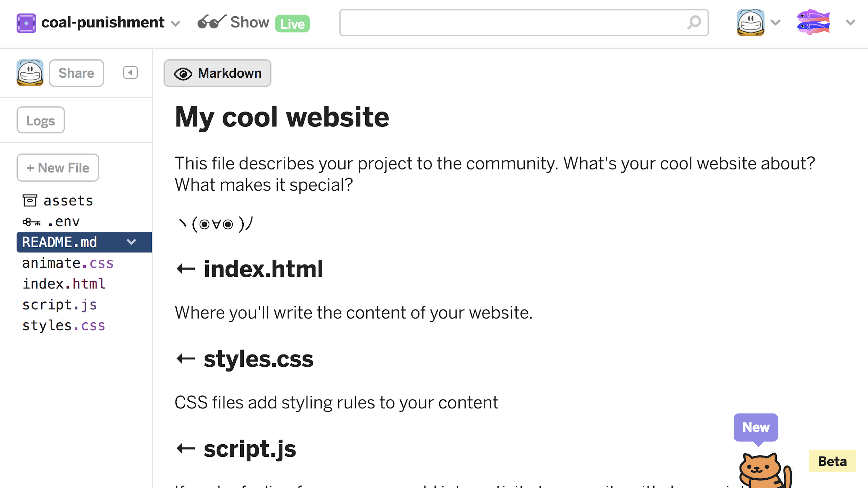
Let’s Use Glitch
Glitch.com. Why?
Supports image uploads through a CDN
Close to “real” development environment
Supports Node out of the box
Has a cat in the bottom right corner
Free

Slide 4
CSS
Chicken Salad Sandwiches

Slide 5
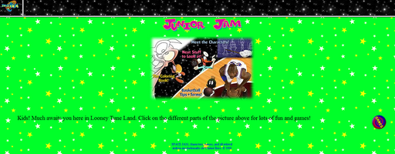
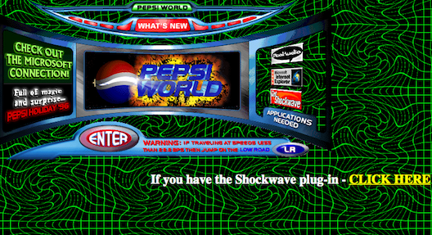
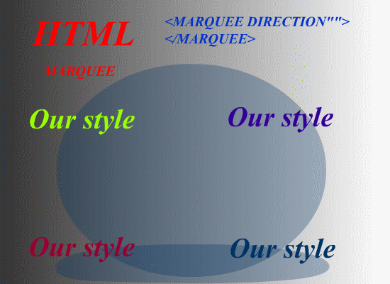
Our websites are boring
LET’S ADD SOME STYLE!!!!
…. maybe not like that

Slide 6
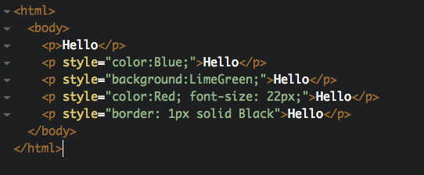
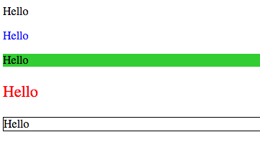
Tags can have style attributes
We can style our elements with the style attribute:
Refer to the resources here:
https://developer.mozilla.org/en-US/Learn/CSS/Basic_text_styling_in_CSS
https://developer.mozilla.org/en-US/docs/Web/Guide/CSS/Getting_started/Color

Slide 7
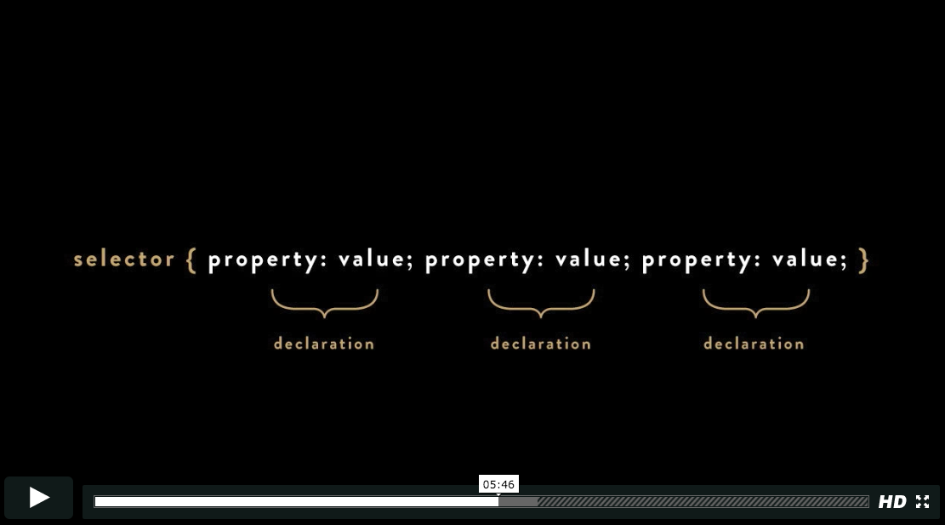
Video: Using CSS

Slide 8
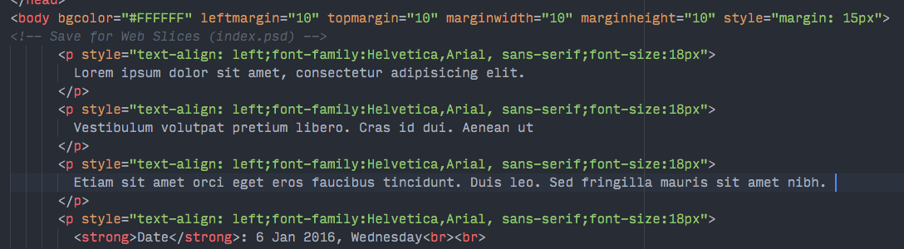
Why CSS?
Because writing your HTML like this:
… is tedious and error-prone. (The above is from a real HTML email, which doesn’t allow CSS, yuck.) Coders like to separate structure from style, so we put HTML and CSS in separate files.

Slide 9
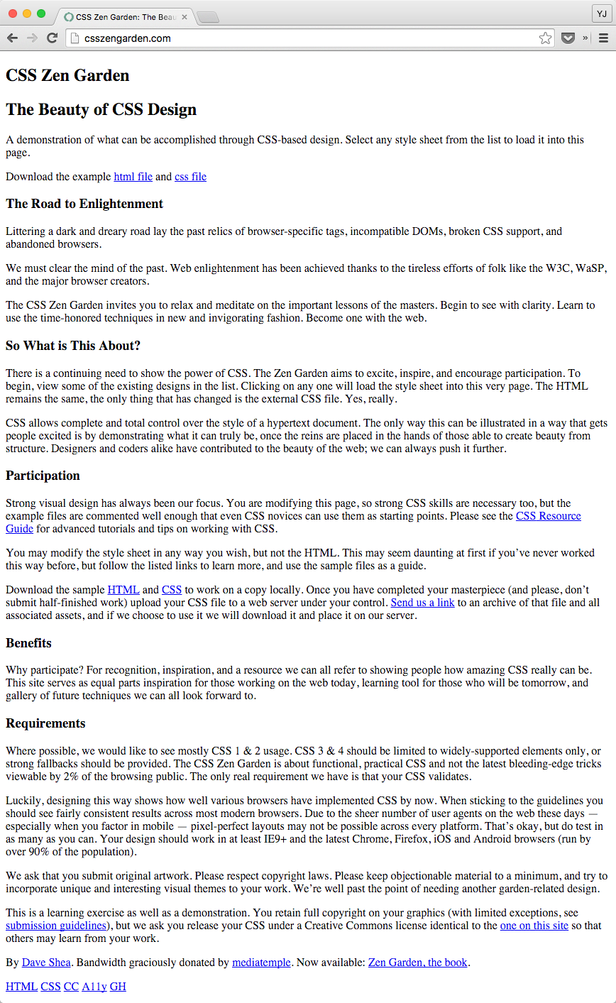
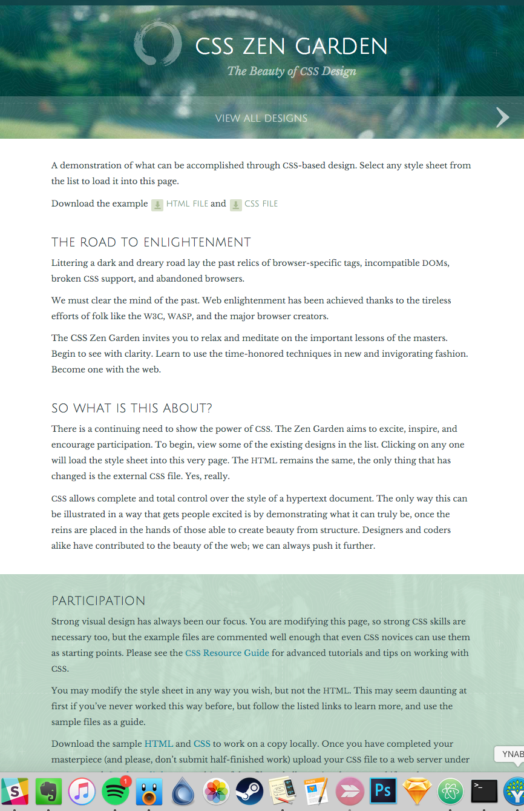
csszengarden.com
Notes:
On the left is what the site looks like, without CSS. On the right (and on the site itself), you can click through what designers have done with the same HTML but different css.

Slide 10
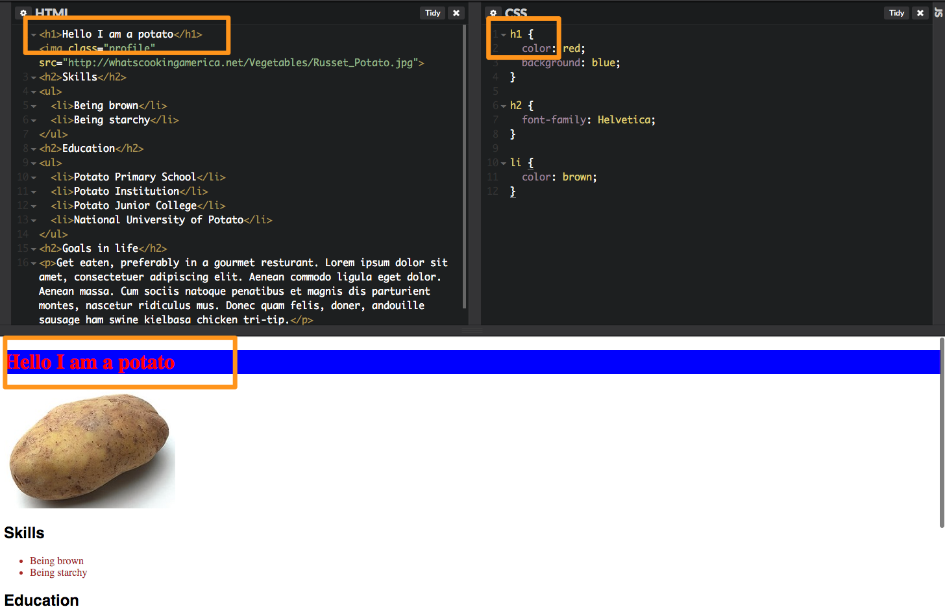
CSS in CodePen

Slide 11
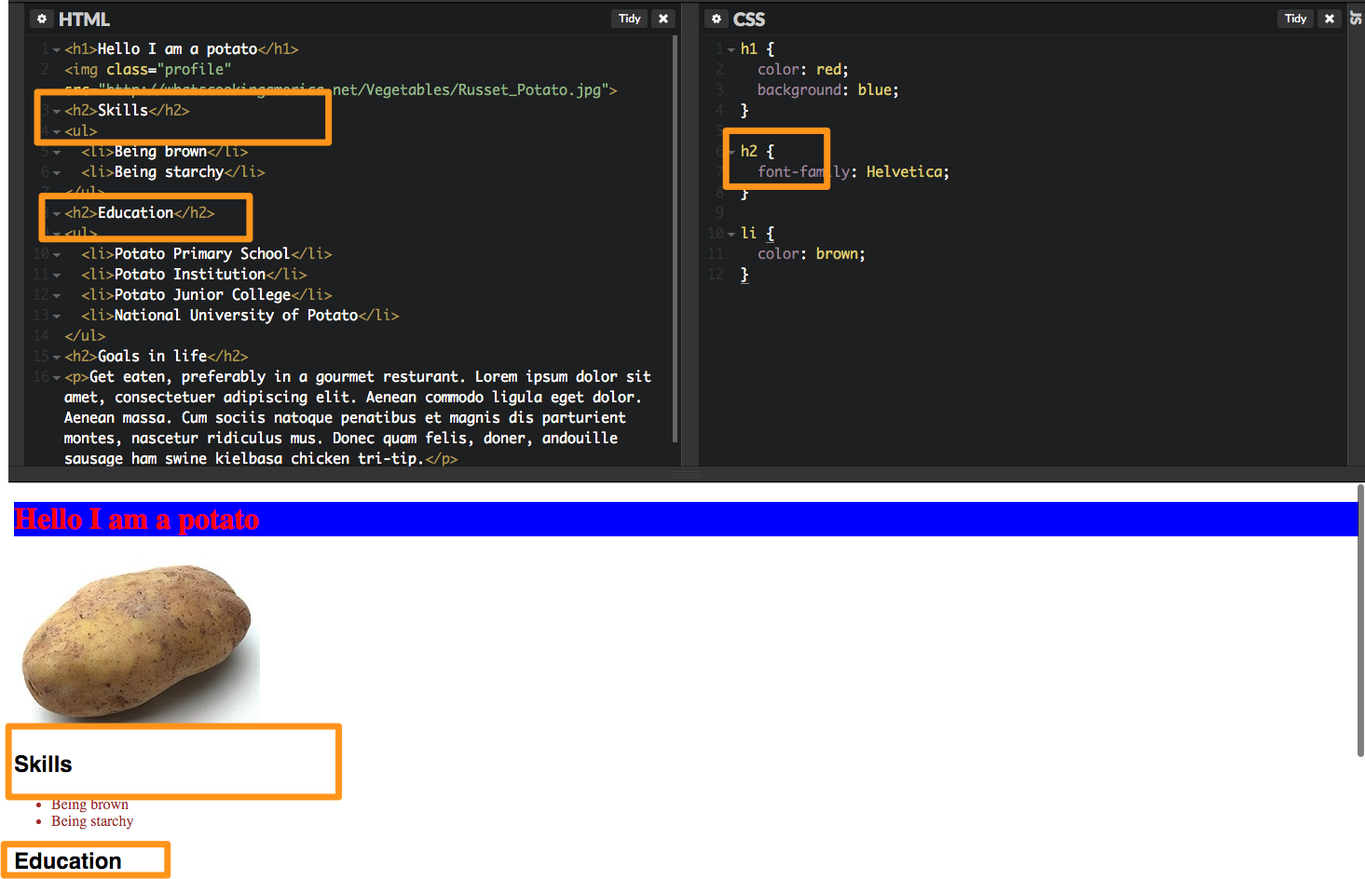
CSS in CodePen

Slide 12
How to write CSS
selector {
property: value;
property: value;
}
h1 {
color: red;
font-size: 22px;
}
The selector is to let you select what you want to apply this style to.
In the last example, we selected all h1 tags, h2 tags, and li tags.
There are various properties you can look up, and certain values they can take. See http://www.htmldog.com/references/css/properties/ for a list!

Slide 13
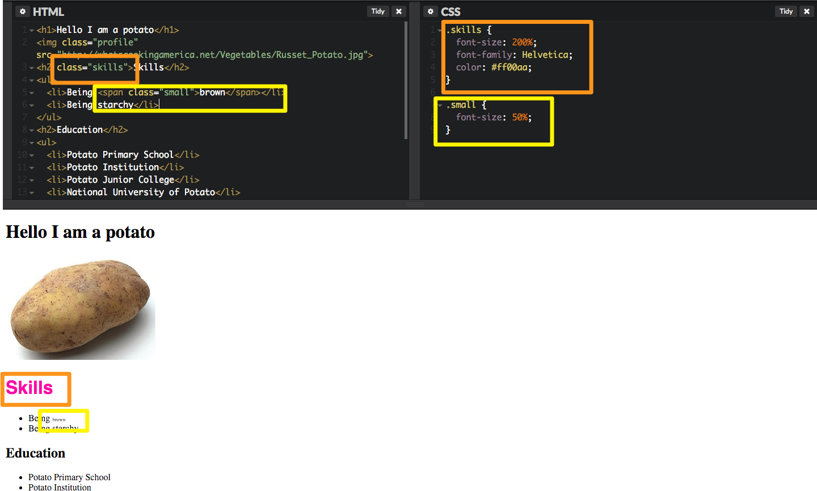
Selecting with IDs and Classes
What if you don’t want to select all instances of your h1s, but just (say) one or two?
You can use a class or id attribute, and style that:

Slide 14
Grouping things
What if you want to group some things together, say a h1 and then a ul?
You can surround them in a div — that’s a “division”, an invisible box (that you can make visible!)
What if you want to style some text within your paragraph?
You can surround that text in a span, then give that span a class, which you can style with CSS
<div>s are boxes, <span>s are inline elements

Slide 15
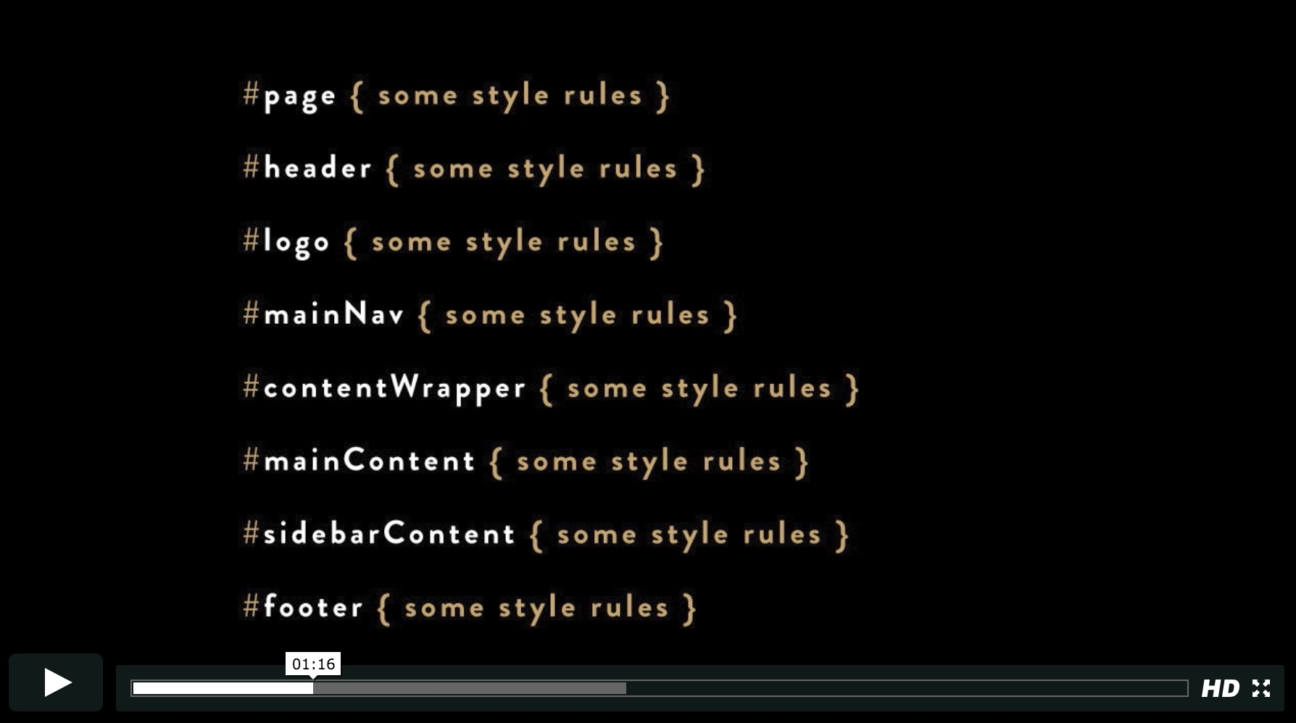
Video: IDs and Classes

Slide 16
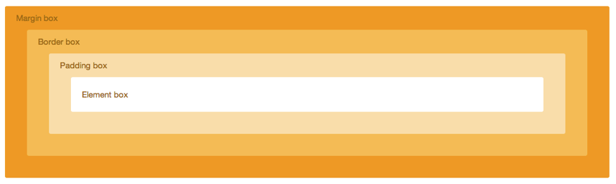
The Box Model
margin: 10px
border: 10px solid orange
padding: 10px
Demo: http://codepen.io/yjsoon/pen/ixlLA

Slide 17



Arranging Things
float: left / right
clear: left / right / both
position: static / absolute / relative / fixed
Demo: http://codepen.io/yjsoon/pen/CBmyg

Slide 18
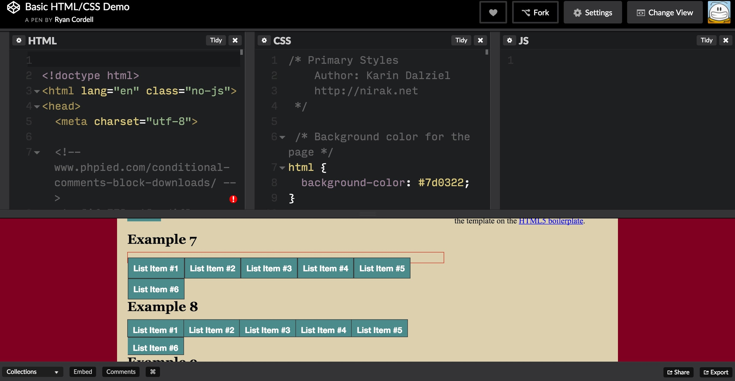
Link: Summary Demo

Slide 19
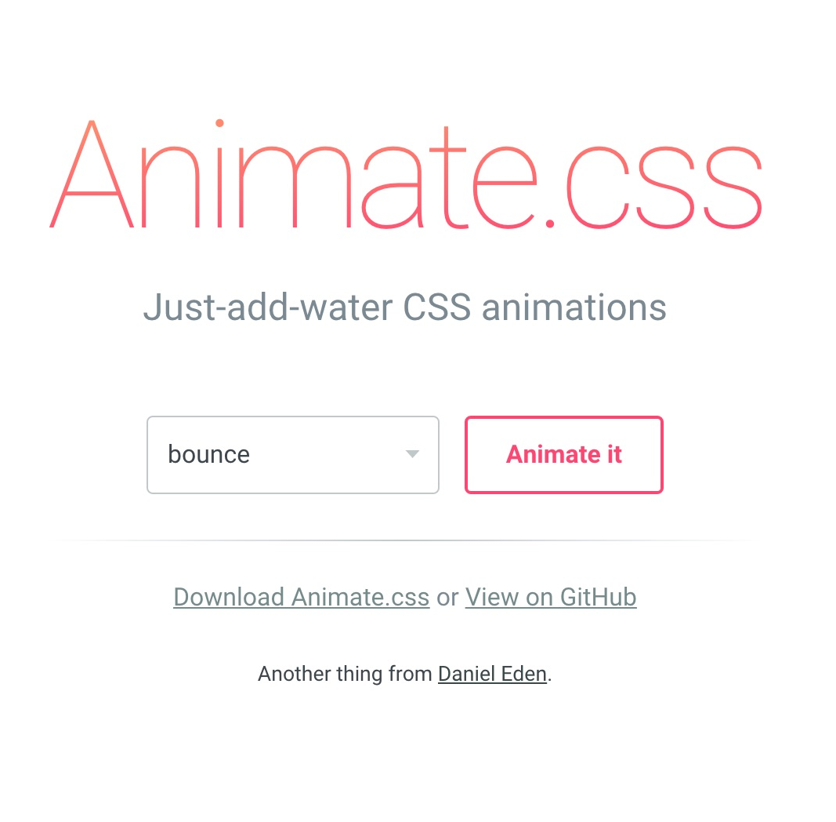
Animate.css
How to use?
Demo webpage: https://daneden.github.io/animate.css/
Go to the GitHub page: https://github.com/daneden/animate.css
Follow the instructions on “Basic Usage”

Slide 20
Exercise (20 minutes)
Spruce up your profile page with some CSS and DIVs to section things out.
Some properties you might want to use: background-color, padding, margin, font-family, border, float, opacity, border-radius.
See the potatoes now.

